Slide 1
A Surface Physics Puzzle
Investigating the validity of the SPI Approximation

Slide 2
Overview
Introduction
The CO/Pt(111) system
Experimental background
³HeSE – a powerful new technique
A puzzling paper
My objectives
  Learning to use DFT
  Setting up surfaces
  Adatoms
  Monte-Carlo simulations

Slide 3
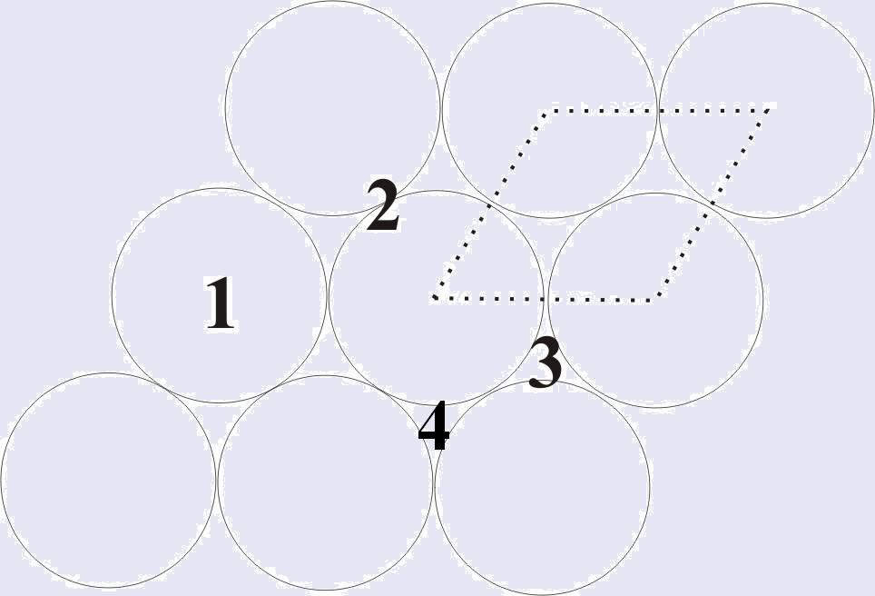
The CO/Pt(111) System
Pt(111) surface is a hexagonal lattice
CO can bind to one of four sites:
  Atop (1)
  Bridge (2)
  HCP hollow (3)
  FCC hollow (4)
CO coverage, θ, is expressed in ML
This releases energy – the binding energy

Slide 4
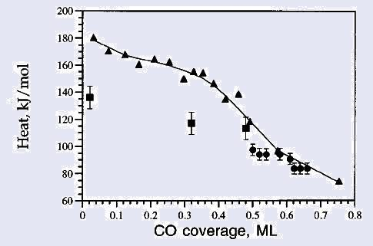
Introduction
CO/Pt(111) is a very widely studied system
Previous studies show a decrease in binding
energy with increasing adatom coverage θ
This was explained by the SPI approximation
A 2008 paper by Alexandrowicz et al. casts
doubt on this
New technique observed uncorrelated motion
- no repulsion?
My aim is to help resolve this puzzle
Heat of adsorption against coverage, from Yeo et al., 1997 (triangles), and Steininger et al., 1982 (circles and squares)

Slide 5
Experimental background
Many studies of CO/Pt(111) have been carried out – using eg. SCAC, LEED, EELS
These studies give results like fig. 1
Studies like LEED which explicitly visualise the overlayer show ordered structures at high θ
This led to the SPI approximation
This now has a large body of evidence to back it up

Slide 6
³HeSE – a powerful new technique
Beam of ³He ions
Focus and polarise
Add phase to spin
Scatter
Repeat in reverse order
Intensity phase wavelength energy
Two beams for time resolution
Focuser
Polariser
Magnetic coil

Slide 7
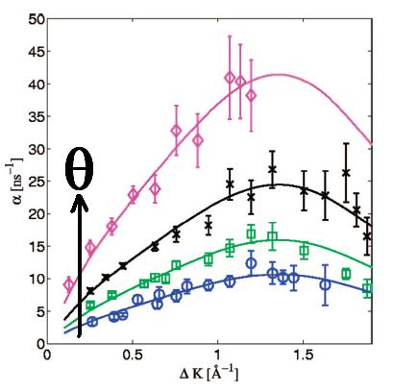
A puzzling paper
3HeSE measures proportional to the ISF
With random motion, this decays exponentially- measure decay constant
With correlated surface motion, expect ordered surface structure
This should give a peak where R_{nn}.ΔK₁=π, as the optimal contribution vanishes, leaving only short-lived random structures
It should give a dip where R_{nn}.ΔK₂=2π, as optimal structure dominates
This was not reproduced, either in experiment or in MD simulations within the SPI. A new model was proposed

Slide 8
My objectives
Learn to run the PW-SCF (DFT) code:
  Learn about the inputs, including various parameters
  Set up inputs for eg. free space CO, bulk Pt
  Investigate convergence of results with respect to some of the parameters
Set up Pt(111) surfaces
Add CO atoms
  Investigate different binding site energies and coverages
  For some larger cells, investigate binding energy against adatom separation
Develop a Monte-Carlo simulation of the system, to compare with the MD simulation of Alexandrowicz et al.
  Use this to investigate interaction-dependent
  adatom dynamics

Slide 9
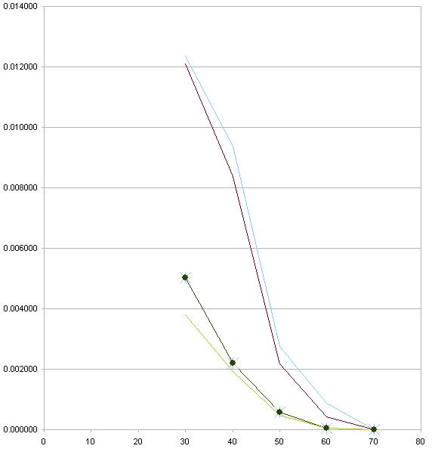
Objective 1 - learning
PW-SCF is a versatile free DFT code
Input file specifies parameters including: atomic positions, k-point grids, and energy cutoffs
First test run – free space CO. Compare results to previous data
Investigate plane-wave cutoff
Set up bulk Pt – requires more
care
This is due to k-points…

Slide 10
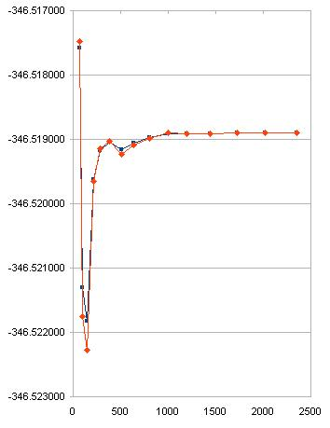
k-points
DFT code calculates energies by sampling band structure in k-space
For metals, this is complicated – need many more k-points than for eg. CO
Must test convergence against k-point set
This is one of the main slowdowns in any DFT calculation
The good news: only k-point density is important – larger cells need less k-points
More good news: for a slab geometry, only need to sample in 2D

Slide 11
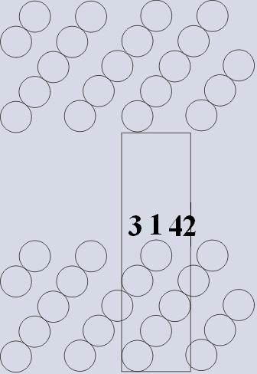
Objective 2 – Pt(111) surfaces
Set up p(1x1) surface cell, extended for 5 atomic layers
Allow a 7 layer vacuum gap to prevent self-interaction
Can also set up eg. p(4x4) cells to allow lower coverages
Allow cell to relax to calculate surface to add CO to

Slide 12
Objective 3 – CO adatoms
Place CO atoms (C down) an arbitrary distance above one of the sites
Allow system to relax again to ensure CO is adsorbed
Calculate the binding energies of the various sites, for a p(1x1) cell with θ=1
Investigate lower coverages (in larger cells)
Compare binding energies for different adsorbed CO geometries, with different separations

Slide 13
Objective 4 – Monte-Carlo
Develop a continuous time Monte-Carlo simulation of the system
The time step for each Monte-Carlo sweep is determined by the lifetime of the movement process, given by the activation energy
Calculate numerical values for the ISF after various time steps
Work out the decay constant
Plot as in Alexandrowicz et al.

Slide 14
Summary
The SPI assumption is extremely important in surface science
New results call its validity into question
Hopefully, well-converged ab initio DFT calculations will shed some light on this
Monte-Carlo simulations are also useful for investigating surface dynamics
Always have a contingency plan!

